Slide 1

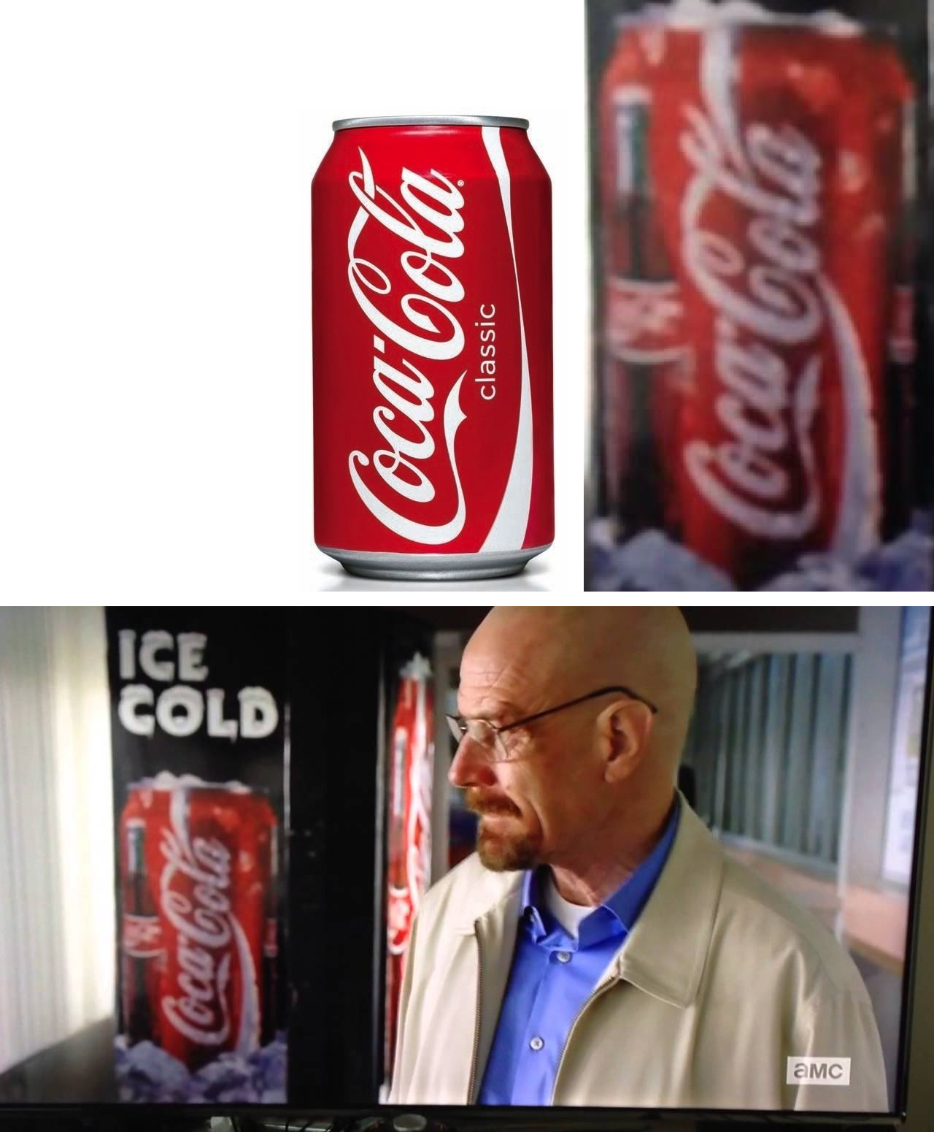
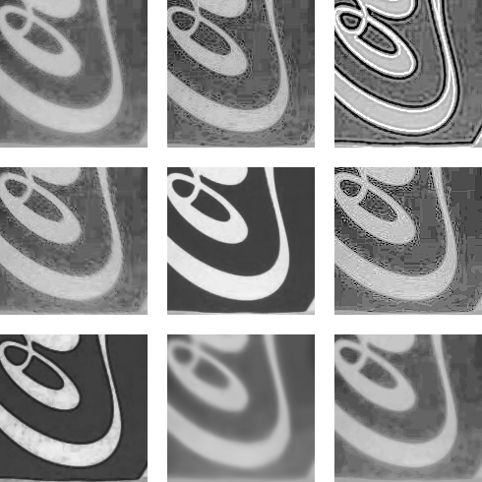
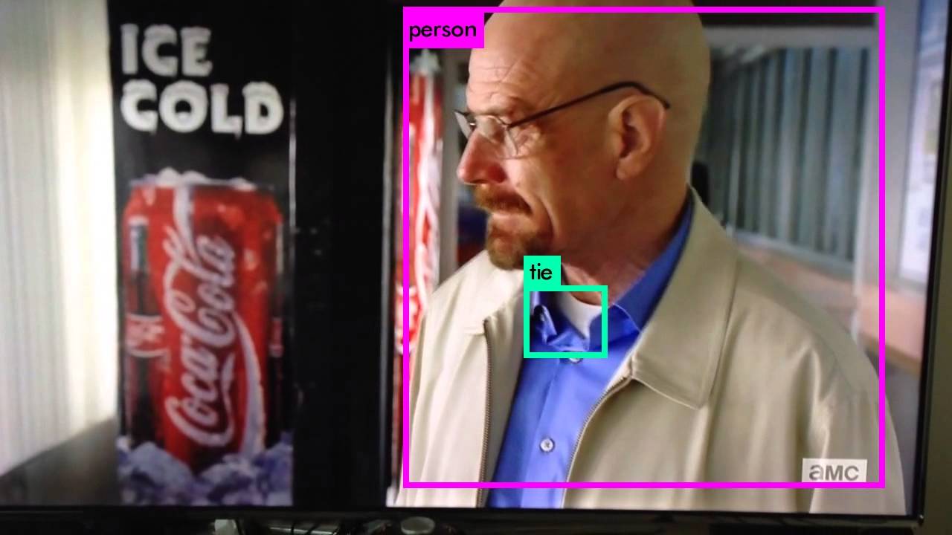
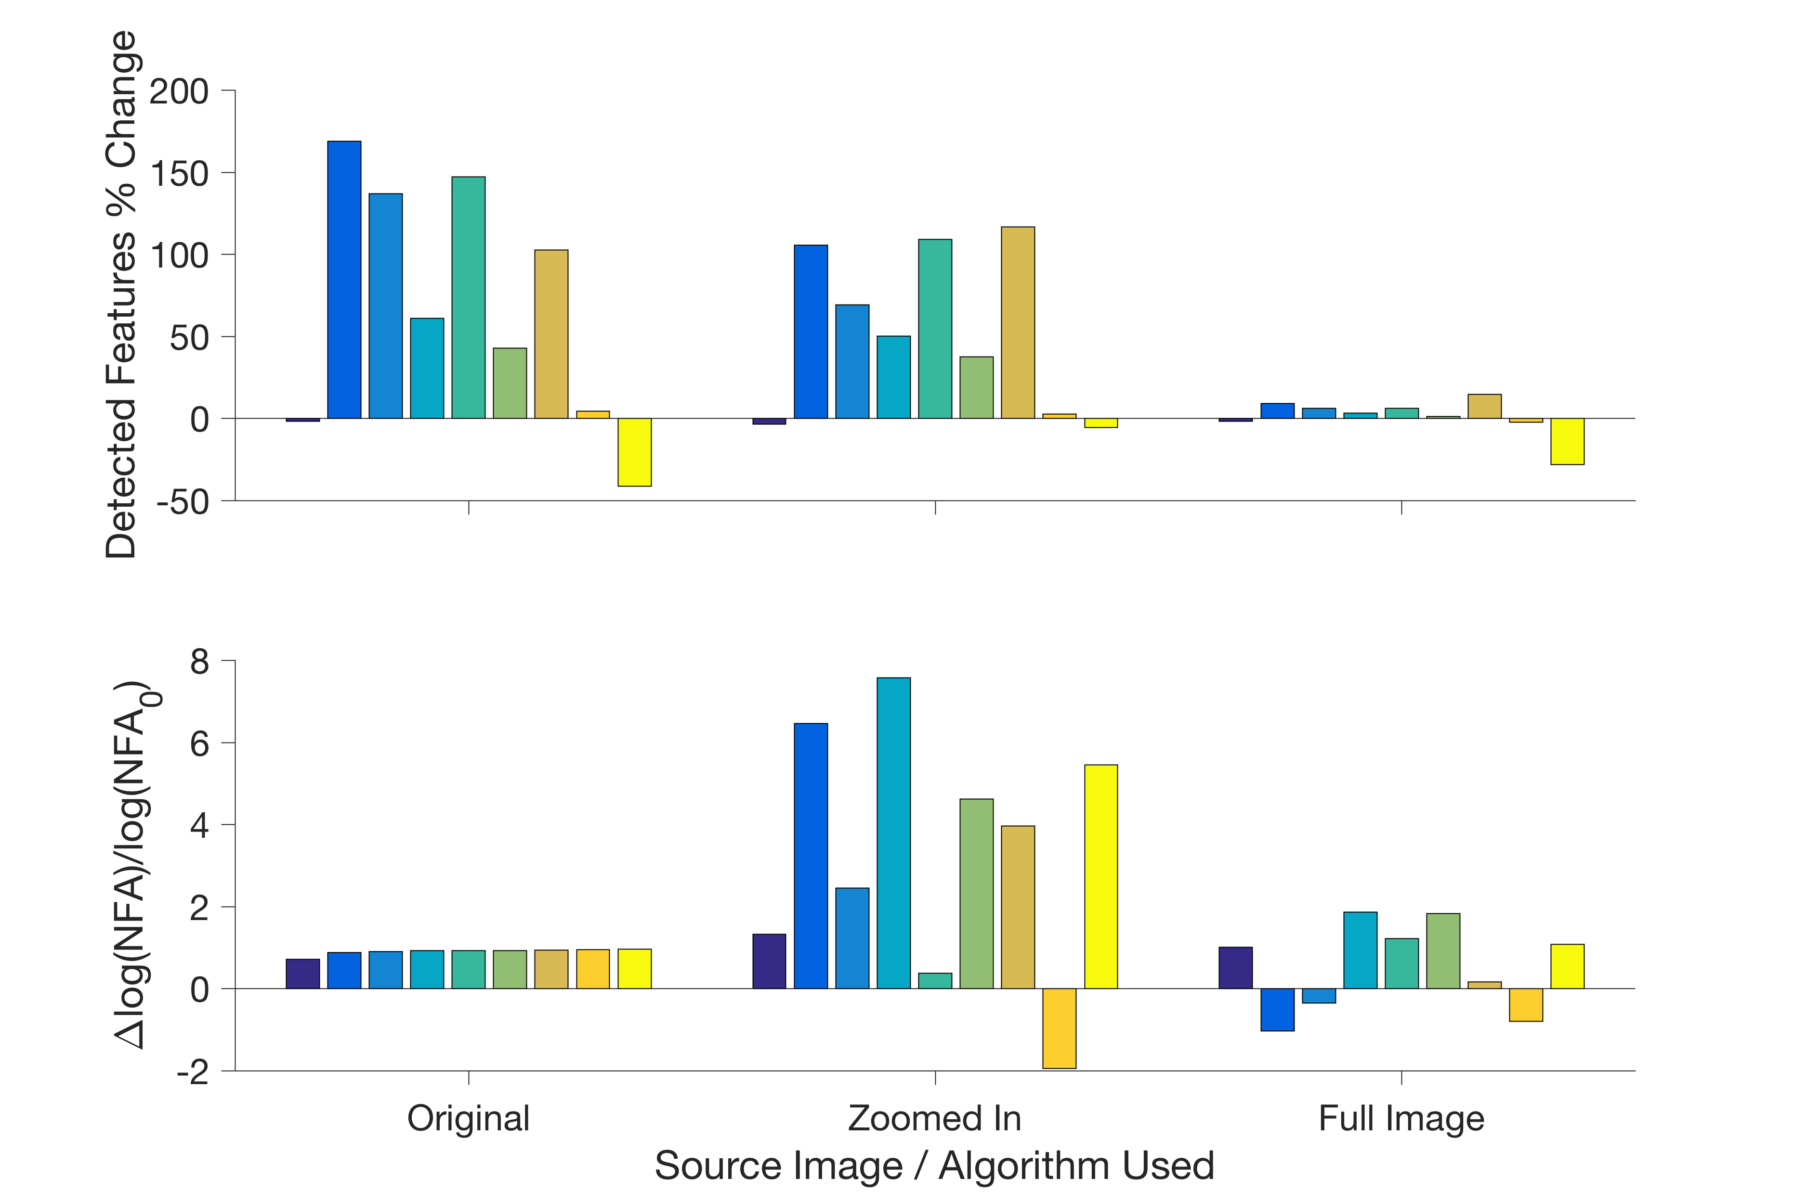
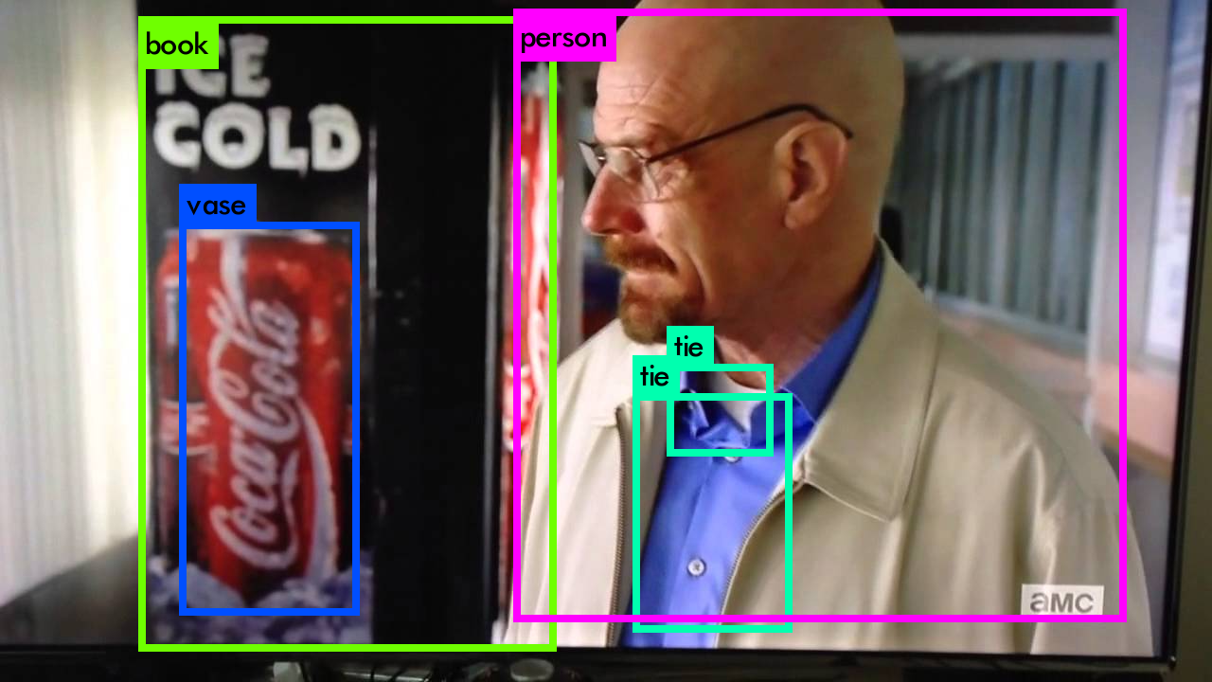
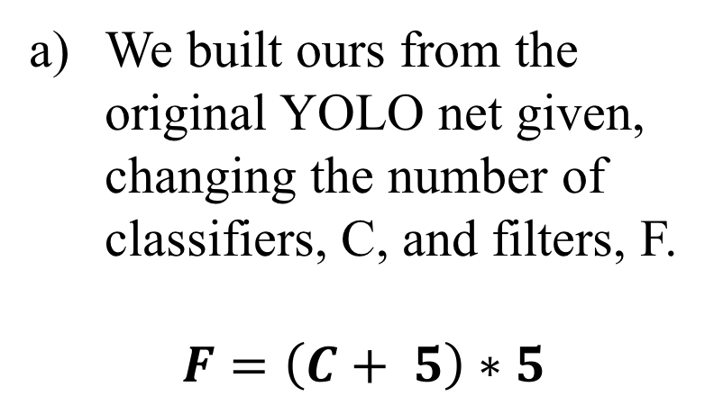
Logo Detection Using Machine Learning versus Asynchronous Scale-Invariant Feature Transform
Matias Lopez †∂, Lucia Martos†, Alex Zaldastani†
† Department of Electrical Engineering, Duke University, Durham, NC ∂ Department of Biomedical Engineering, Duke University, Durham, NC
Abstract
Machine Learning
Methods: ASIFT
Deep brain stimulation (DBS) is a clinical therapy for treatment of several neurological conditions, including movement disorders such as Essential Tremor (ET) and Parkinson’s Disease (PD). While DBS is clinically efficacious, much work remains to be done in terms of understanding how DBS stimuli affect surrounding neural elements, which can have major implications for clinical outcomes. Neural recordings such as Evoked Compound Action Potentials (ECAPs) or Local Field Potentials (LFPs) may offer valuable insight. However, a major technical barrier for using ECAPs to analyze DBS is the presence of stimulation artifacts that are orders of magnitude larger in amplitude than the desired ECAP signal. Artifacts contaminate the integrity of neural recordings, complicate isolation of potentially meaningful signals, and easily saturate amplifiers. The objective of this project is to make improvements upon existing recording equipment in order to increase the fidelity of acquired neural signals, an advancement that may greatly enhance the utility of ECAPs recordings for clinical use. Here, a user interface was written and a connection hub was designed to control stimulation and recording. The efficacy of the build is currently being tested in vitro using a passive volume conductor model of brain tissue. Successful completion of this project should substantially improve the quality of ECAPs recorded during DBS, which may ultimately facilitate the translation of ECAPs analysis into clinically meaningful outcomes.
Scale Invariant Feature-Transform is a good algorithm to detect if a feature like a logo is present in an image.
Affine SIFT or ASIFT is used instead because SIFT is limited to features with the same orientation as the original image.
ASIFT performance drastically drops when the image quality drops, and improves when the image region of interest is isolated.
The reference image tested on is a good quality image of a Coca Cola can.
Training Classifier
Algorithms
The test image is a scene from a TV show featuring a similar can, and a third image zooms in the can featured in this scene.
IBM Watson (Simplest):
Go to https://visual-recognition-demo.mybluemix.net/train
Upload a dataset of images that you want to train on, specify positive and negative examples
Simply upload an image, the output will then be a JSON file which says which indicate classifiers have the greatest matches
TensorFlow: TensorFlow is an open-source software library for numerical computation using data flow graphs. We simulated logistic regressions, linear regressions, etc. (see in references)
Darknet: Open source neural network framework written in C and CUDA.
Darkflow: We were recommended to use Darkflow, a translation of Darknet to TensorFlow, by people who had worked with TensorFlow . This method gave several issues so it wasn’t explored further.
YOLO: This algorithm, built on Darknet, was chosen because we were looking to build a classifier that was really fast at a minimal cost to accuracy, since, ideally, accuracy was going to be done by ASIFT at the cost of speed. Previously object detection repurposes classifiers to perform detection. However, now we frame object detection as a regression problem to spatially separated bounding boxes and associated class probabilities. A single neural network predicts bounding boxes and class probabilities directly from full images in one evolution.
Enhancing Algorithms Used
Custom affine anisotropic filter
Gradient multiplied filter
Gaussian deconvolution
Directional gradient weighted average Filter
Non-equalized median filter
Color contour averaging
Non-equalized Inverse gradient dependent median filter
Reference trained sparse encoding
Equalized median filter
Objectives
Improve the recording equipment already used to study the effects of DBS.
Long Term: Relate Evoked Compound Action Potentials (ECAPs) to motor function and develop a closed-loop DBS system.
Successful completion of this project will improve the quality of ECAPs recorded during DBS and facilitate more efficient conduct of research studies
Conclusions
Results: ASIFT
Developed a modular, easily reproducible platform that will be used to investigate Deep Brain Stimulation.
Modular programming is faster to implement and easier to reuse
With a few files, all parts can be ordered/machined/assembled increasing reproducibility
Ongoing testing to ensure reliability of the new build
The largest problem with enhancement is that while features were sharpened, so was the noise in the image.
Filters a through i are shown left to right, top to bottom
Detection of the Coke can in the test image was not successful.
ASIFT was not robust enough to handle finding a logo in different images when the resolution is low.
The only improvement in detection of low quality images came at a large computational cost
References
You Only Look Once
We built ours from the original YOLO net given, changing the number of classifiers, C, and filters, F.
$$F=\left(C+ 5\right)∗5$$
[1] A R Kent and W M Grill 2012 Recording evoked potentials during deep brain stimulation: development and validation of instrumentation to suppress the stimulus artefact J. Neural Eng. 9 036004
[2] A R Kent et al 2014 Measurement of evoked potentials during thalamic deep brain stimulation Brain Stim. 8 42-56
Acknowledgements
Create a .data file with the number of classes and the paths to the .txt files with lists training and validation data
Change the .names file to the classifiers being trained
Create .txt files with the paths of the images being trained and validation data
Put training data in the path specified, requires image.jpg and image.txt, annotated in the format <object-class> <x><y> <width> <height>, where everything is in ratios
Give a sample weight file so it can train on
Improving
This work was supported by BioCoRE, Duke University Summer Research Opportunity Program, and NIH R01NS079312. I would also like to extend the thanks to Gilda Mills for her help with background logistics and Alex Kent whose project I am continuing.
Although very computationally costly, the trained sparse encoder performed the best at improving detection.
Worsening
Filters a through i are plotted left to right
However ASIFT did not find any significant matches in the test image, meaning the improvements were still unsuccessful
Although the model was set up successfully, it did not get any meaningful results because dataset was not significant enough or at least too small.
ECE 590: Image and Video Processing – Spring 2017

